Slide 1
RULE UP FOR 3 COLOUMN NOTES

Slide 2
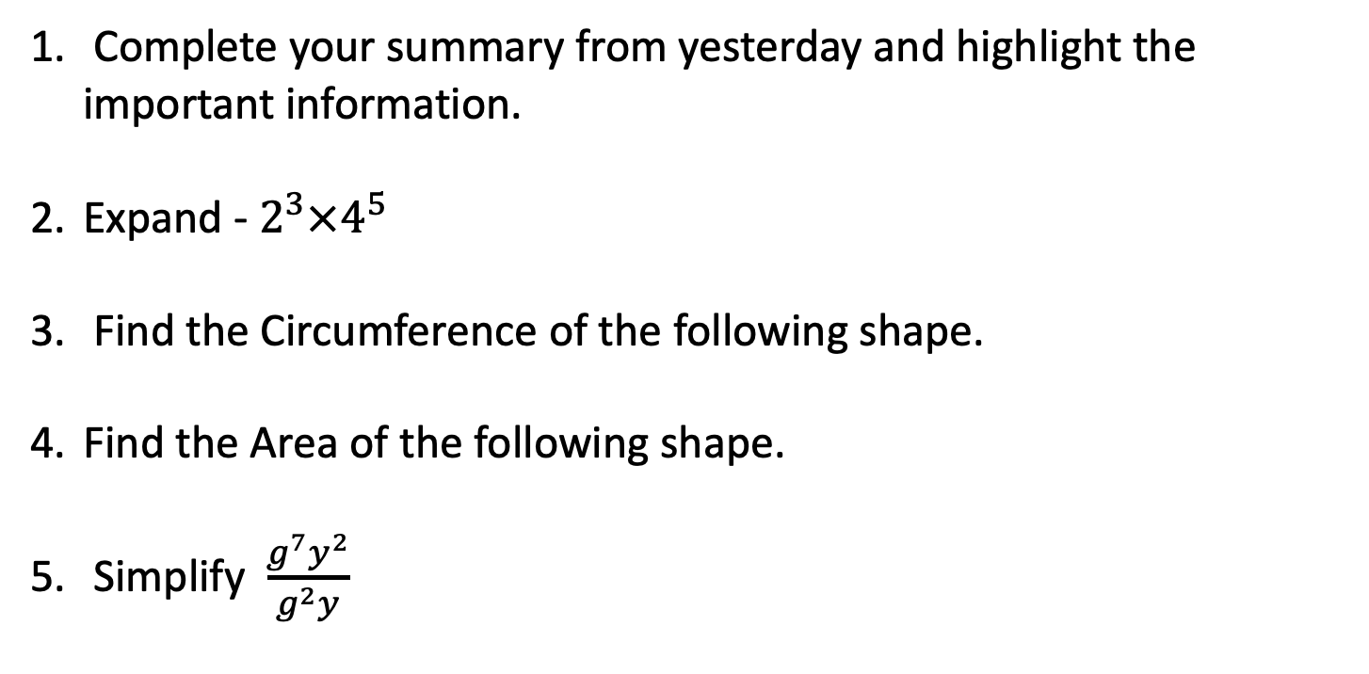
24
7
30
Date
Index Laws
EQ – Describe how the index laws can be used to simplify expressions with indices.
FIRST 5 QUESTIONS
Complete your summary from yesterday and highlight the important information.
Expand - $2^{3}×4^{5}$
Find the Circumference of the following shape.
Find the Area of the following shape.
Simplify $\frac{g^{7}y^{2}}{g^{2}y}$
7cm
5

Slide 3

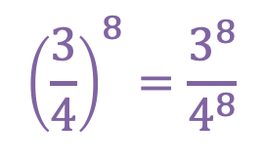



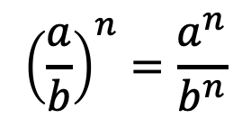
24
7
30
Date
Index Laws
EQ – Describe how the index laws can be used to simplify expressions with indices.
Power of a Power Law
Example
$$({a^{m})}^{n}=a^{mn}$$
$${(x^{7})}^{4}=x^{7×4}=x^{28}$$
How do I use the Power of a power law?
$$({a×b)}^{n}=a^{n}×b^{n}$$
$${(6×3)}^{4}=6^{4}×3^{4}$$
$${\left(\frac{a}{b}\right)}^{n}=\frac{a^{n}}{b^{n}}$$
$${\left(\frac{3}{4}\right)}^{8}=\frac{3^{8}}{4^{8}}$$
5

Slide 4


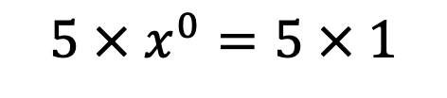

24
7
30
Date
Index Laws
EQ – Describe how the index laws can be used to simplify expressions with indices.
Power to zero
Example
How do I use the Power to zero law?
$$x^{0}$$
$$x^{0}=1$$
$${5x}^{0}$$
$$5 × x^{0}=5 × 1$$
5

Slide 5




We do
$$f^{0}$$
$${3×q}^{0}$$
$$(b^{5})^{2}$$
$$(d^{2})^{7}d^{6}$$
Notes:
There is also worksheets uploaded.

Slide 6
Task
Dwyer Text Book Page 7
Exercise 1.11
Dwyer Text Book Page 8
Exercise 1.11
Notes:
There is also worksheets uploaded.

Slide 7



Exit Ticket
Choose one of the following questions and answer in your books. Show your teacher before packing up your lesson.
A
B
C
$${5×p}^{0}$$
$$(a^{2})^{3}$$
$$(a^{2})^{3}a^{6}$$

Slide 8
Homework
Review your notes and write a summary answering the essential question.

